Slide 1
Welcome to my presentation

Slide 2
5G WIRELESS Technology
Submitted by:
Md. Touhidul HASAN
Id:203-15-14552, Section: c

Slide 3
overview
INTRODUCTION TO WIRELESS COMMUNICATION
EVOLUTION FROM 1G TO 4G SYSTEM
5-G WIRELESS SYSTEM
COMPARISON OF 1G TO 5G TECHNOLOGIES
Features of 5G technology

Slide 4
INTRODUCTION TO 5g WIRELESS COMMUNICATION
5th generation wireless technology.
Has incredible transmission speed.
High connectivity.
More power & features in hand held phones.
Large phone memory, more dialing speed, more clarity in audio & video .

Slide 5
EVOLUTION from 1G to 4g
1g : Speed up to 2.4 kbps
2g : Speed up to 64 kbps
3g : Transmission speed from 125 kbps to 2 Mbps
4g : Speed up to 100 Mbps
High performance
Easy roaming
Low cost

Slide 6
5G WIRELESS SYSTEM
10 Times More Capacity And Broadband Capabilities Than Other
Expected Speed 1GB/S
More Faster And More Reliable Than 4G
Mobile Multimedia Communication

Slide 7
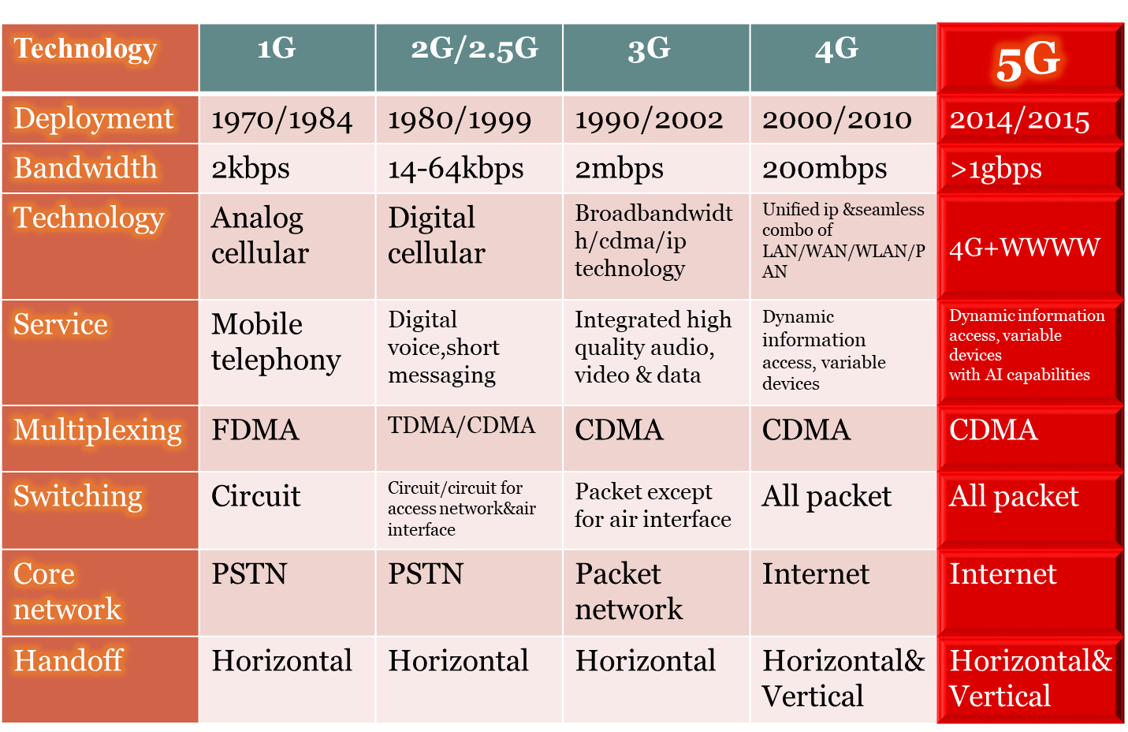
COMPARISON OF 1G TO 5G TECHNOLOGIES

Slide 8
Hardware & Software of 5G
5G Hardware:
5G Software:
Uses UWB (ultra wide band) networks with higher BW at low energy levels.
BW is of 4000 mbps, which is 400 times faster than today’s wireless networks.
Uses smart antenna.
Uses CDMA (code division multiple access)
5G will be single unified standard of different wireless networks, including LAN technologies, LAN/WAN, WWWW- world wide wireless web, unified IP & seamless combination of broadband.
Software defined radio, encryption, flexibility, anti-virus .

Slide 9
Features of 5G technology
Bi-directional Large BW
Less Traffic
25 Mbps Connectivity Speed
Enhanced & Available Connectivity Just About The World
Uploading & Downloading Speed Of 5G Touching The Peak (Up To 1 Gbps)
Better & Fast Solution

Slide 10
Thank You

